Slide 1
TEAM UFO
ISTE 612: Information Retrieval and Text Mining
…Exploring the World Of
Declassified Government Documents…
Cory Maclauchlan, John Myers, Arivirku Thirugnanam

Slide 2
Agenda
01
02
03
04
The problem
The data
Why we developed this software
How we preprocessed and represented the data
MODELS used
results
Indexing and clustering techniques used
What we observed about the techniques
2

Slide 3
The Problem
Periodically, the US Government releases to the public large troves of declassified documents that have been requested.
These documents are all related to the same topic, but vary greatly in what information they provide.
We endeavored to research if there was a way to pore through these documents in a better way to understand them more quickly.
3

Slide 4
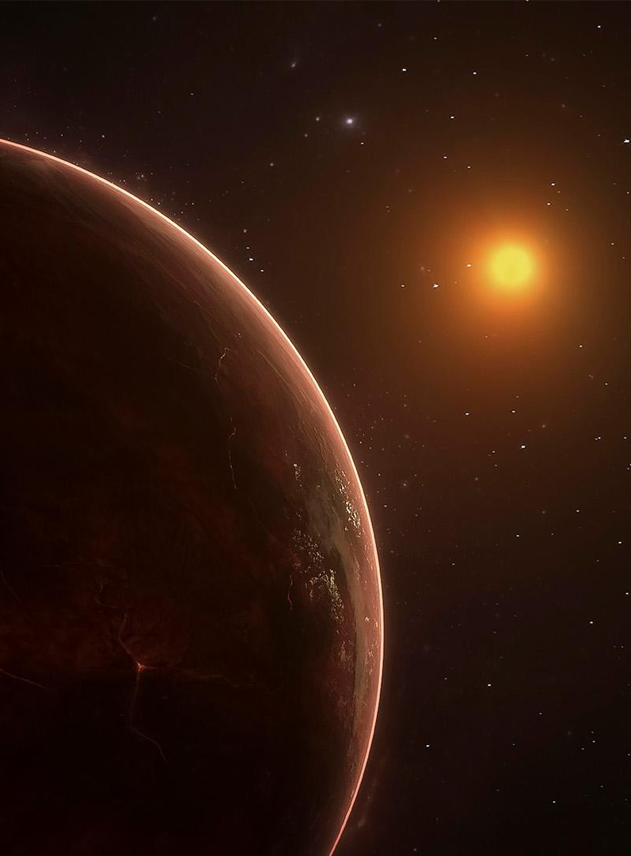
Why develop this for this use case?
The CIA released a large cache of documents in 2021 related to UFOs to “The Black Vault” upon a Freedom of Information Act (FOIA) request.
The document collection consists of a mixture of scans of printed materials with redactions, memo posts and high-quality documents.
The documents are released without labeling or categorization of any kind.
Owing to data quality, classifying or extracting any useful information from the documents would be a tedious process to perform manually and without aid.
4

Slide 5

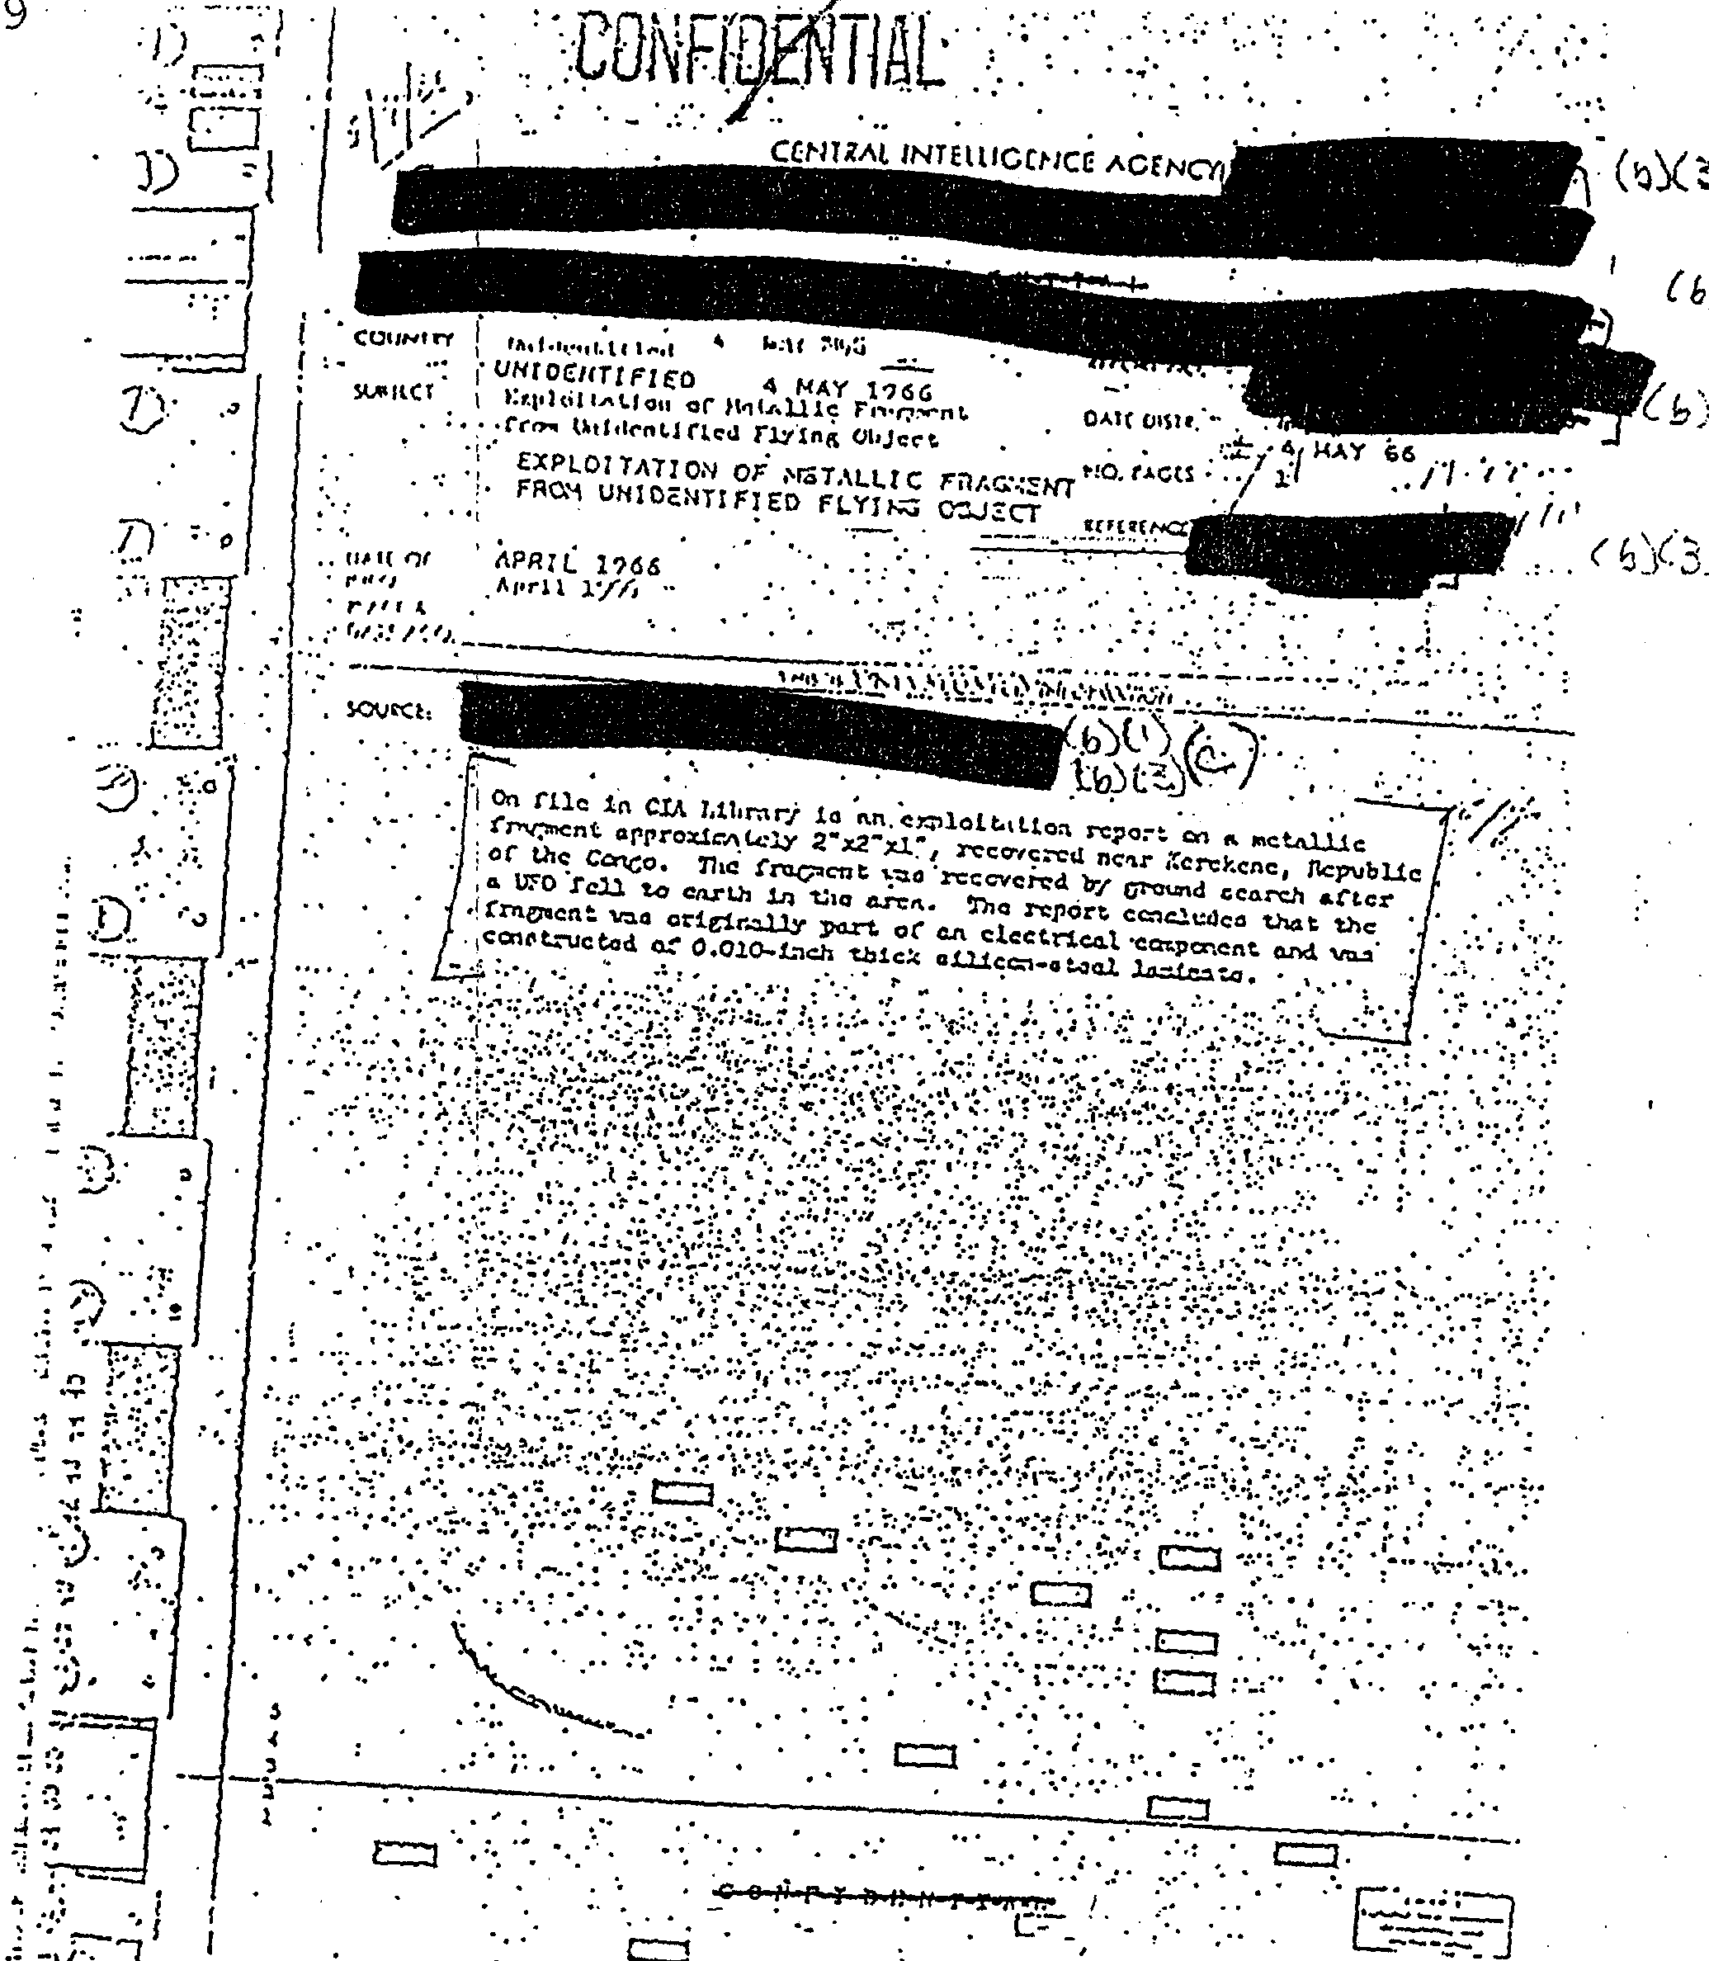
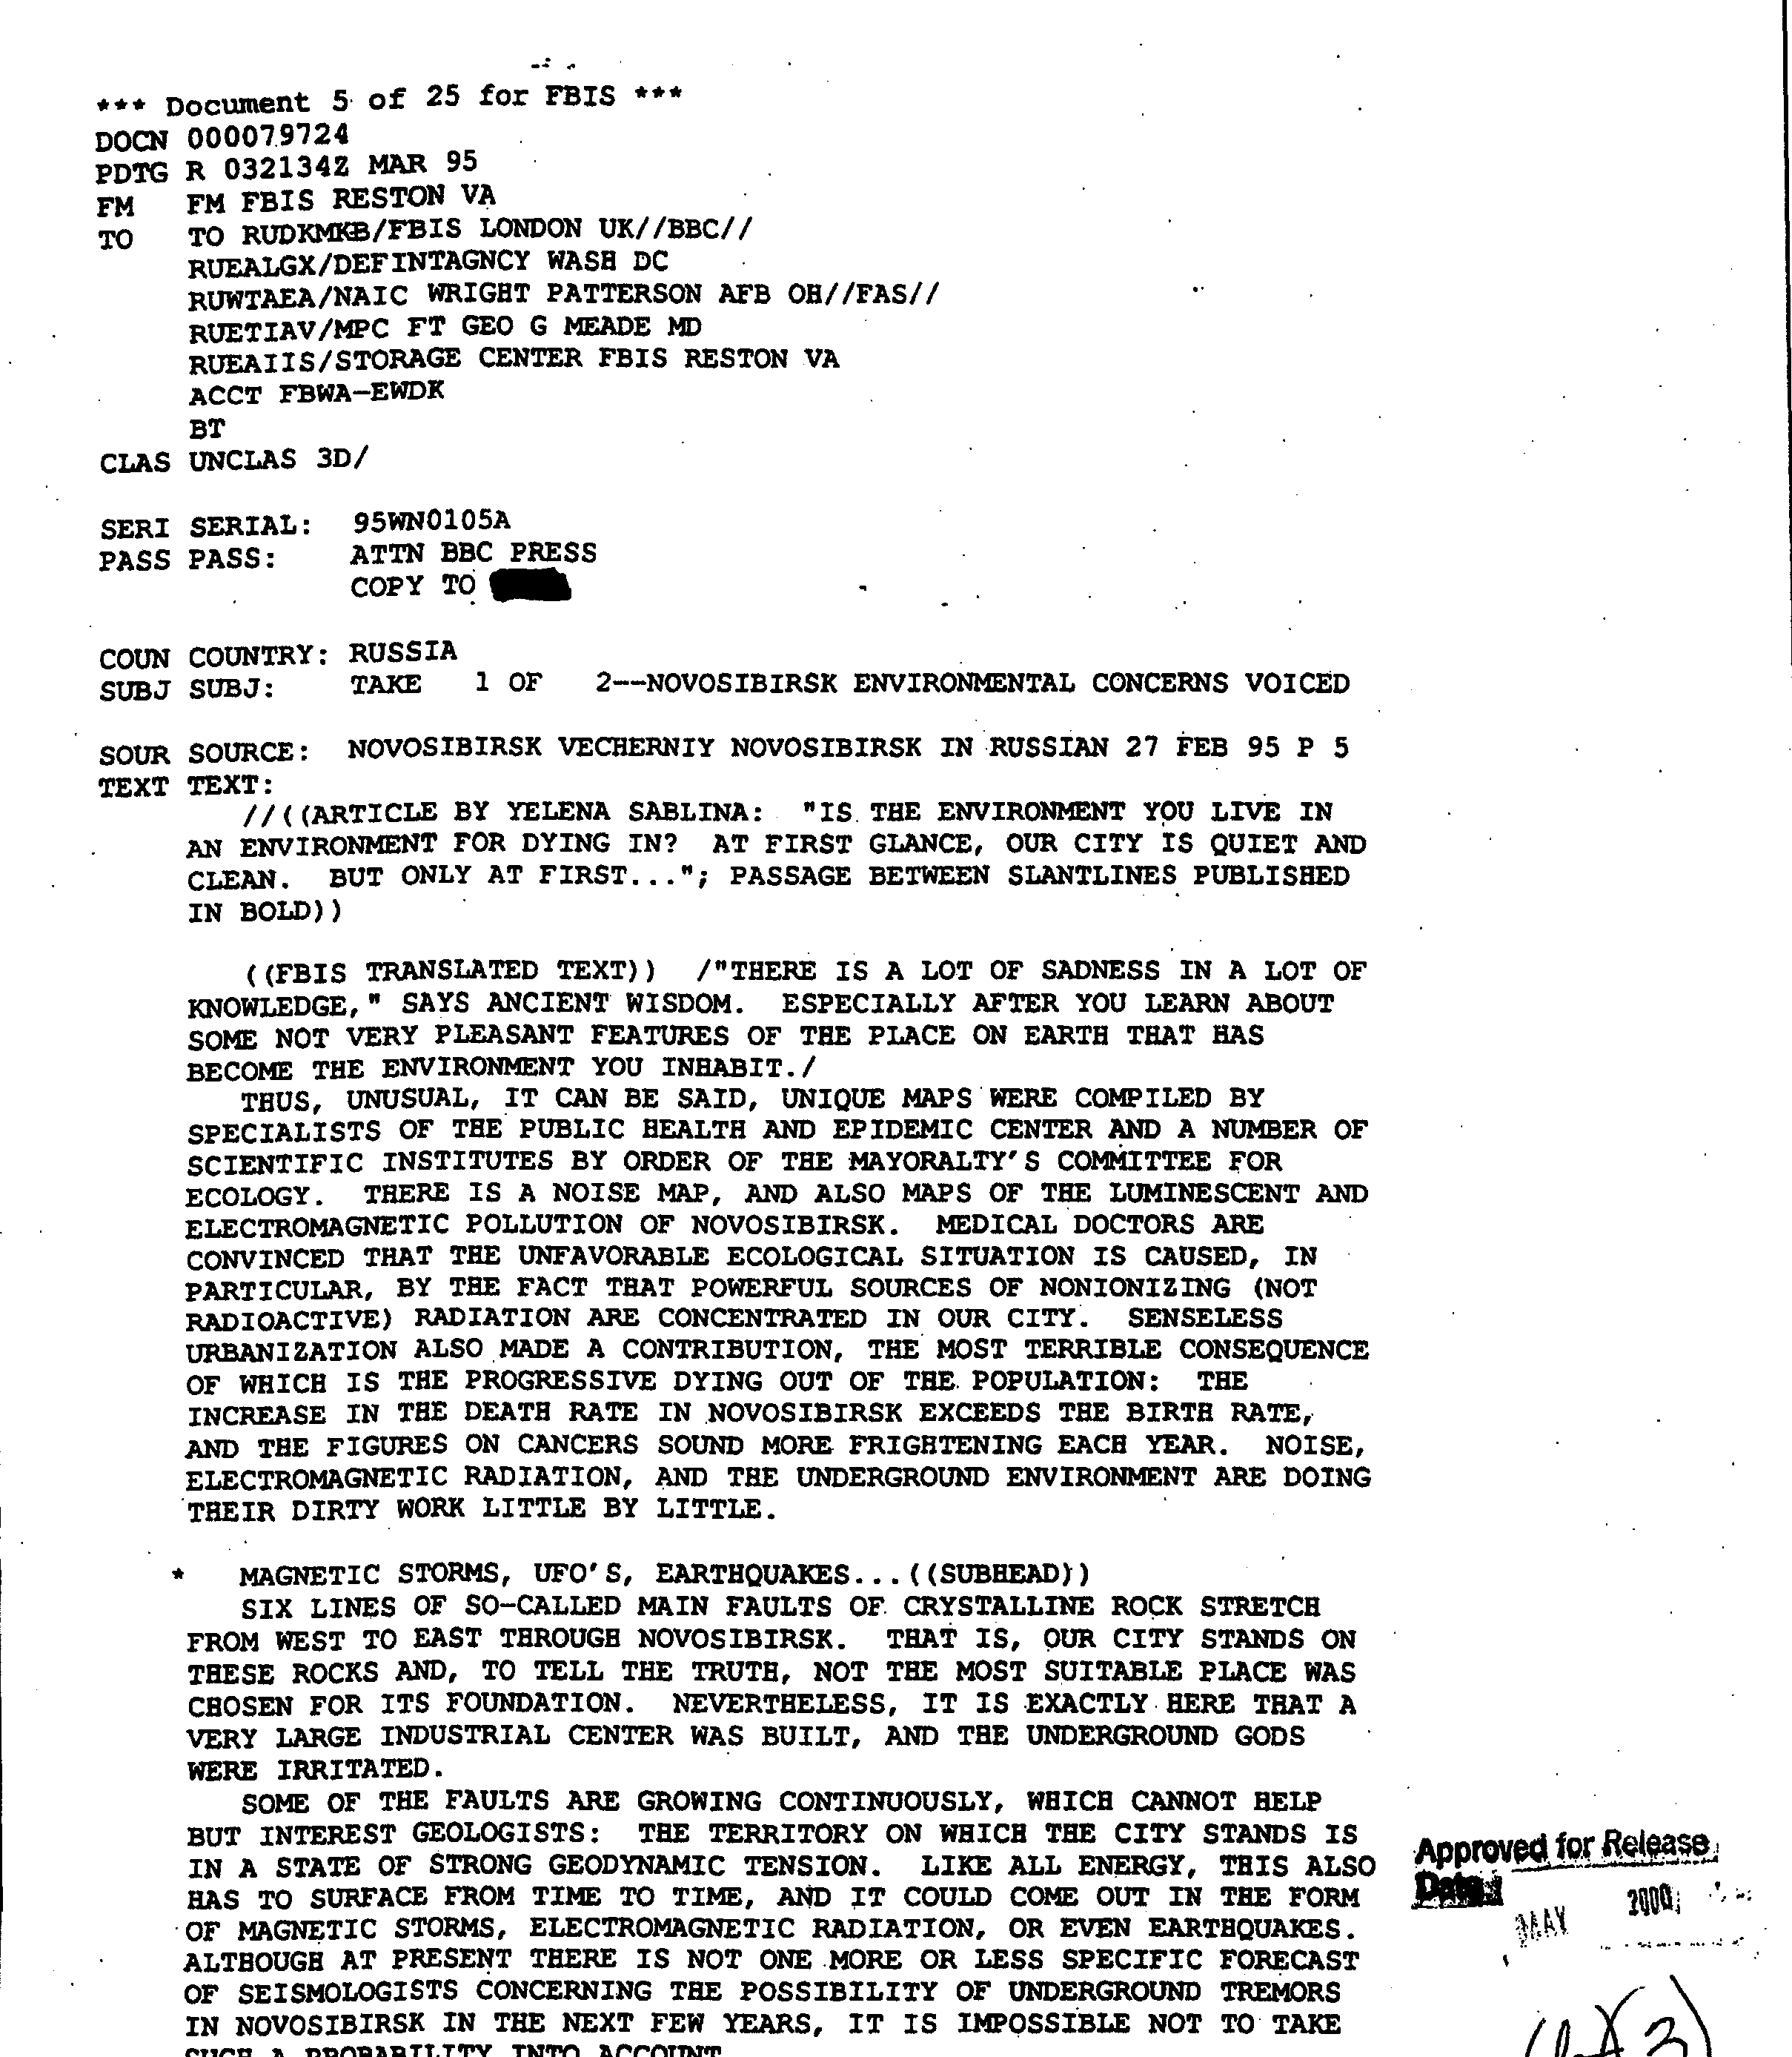
The Data
Low quality
High quality
A total of 712 PDF documents, containing 3493 pages of text related to UFOs were created from TIFF images from the CIA.
5

Slide 6
Data Preprocessing and representation
To analyze the documents, we needed to extract as much text as possible from the produced PDF documents.
We compared the extracted text from pypdf2 and pdfminer and found out that pdfminer has better efficiency and extracted more complete words.
Each PDF document is opened, the text is extracted using pdfminer, tokenized, and imported into memory.
All tokenized words are compared to a Wordnet, and only words with semantics are indexed (ie, we only use actual words in our analysis).
Only documents that have at least three words are used in this analysis.
6

Slide 7
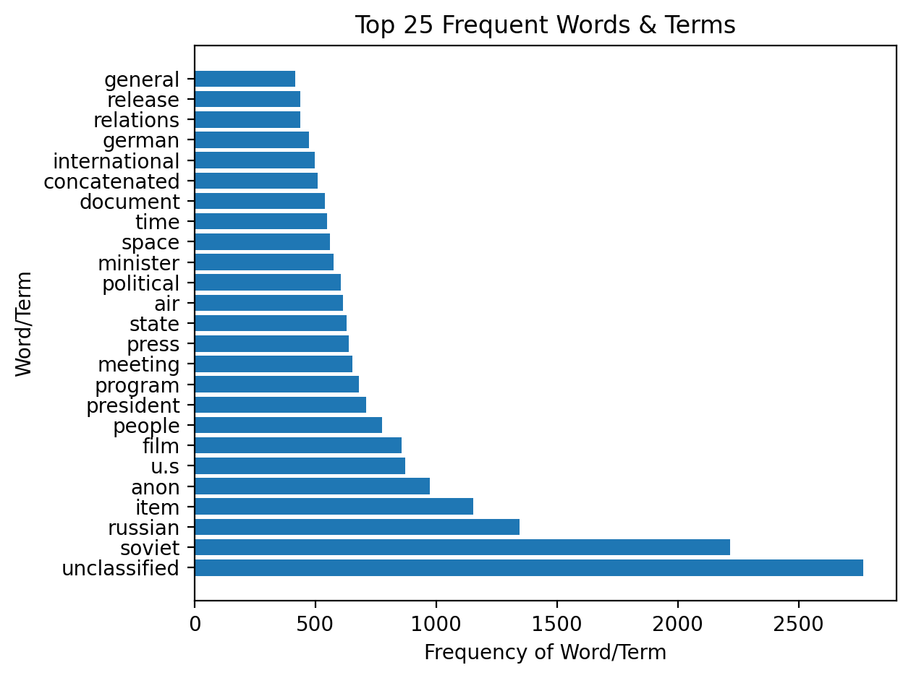
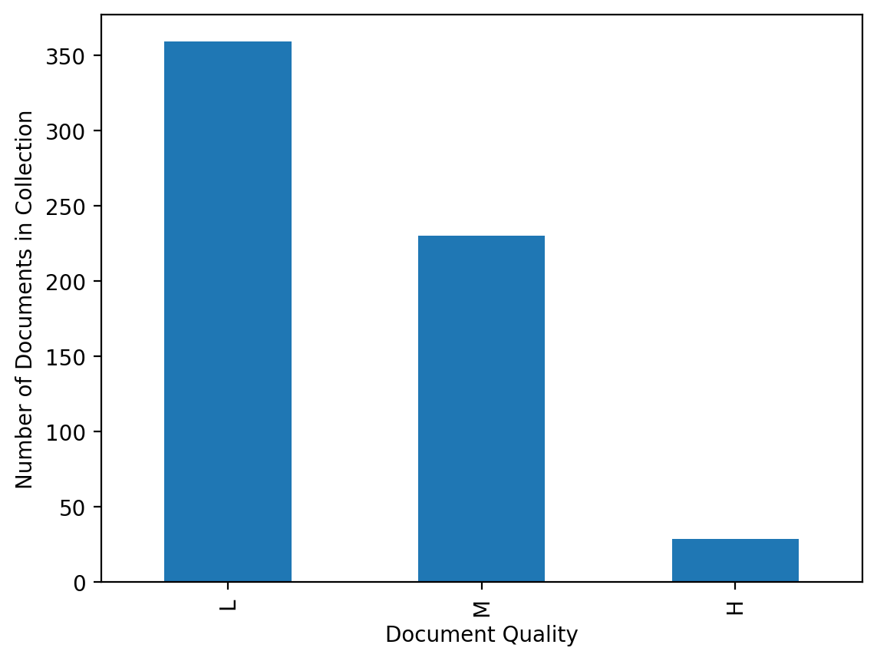
Document set Attributes
Low Quality: 359, Medium Quality: 230, High Quality: 29
In our implementation, 144 MB of PDFs take just under five minutes to upload, parse, tokenize, categorize, and index.
There are 8205 words in the resulting dictionary.
A total of 96 documents have no useful information within them.

Slide 8

Information Retrieval and LEARNING Models Used
K-Means
Vector Space Model
K-Means Limitations:
K-means Clustering algorithm is an unsupervised learning method that requires lots of fine-tuning and one should keep in mind its limitations and drawbacks.
As per my analysis, it doesn’t work well with small size datasets.
It doesn’t perform well on datasets which has uniform Distribution.
It needs to find some optimal value of k using some external methods before feeding it to the algorithm’s parameter.
A Vector Space model with tf-idf as score parameter is used to build a search engine to rank-order the documents matching the input query.
Cosine similarity is used to determine the closeness against the documents.
The importance of using tf-idf is to increase the weightage of uncommon/important terms and decreasing the weightage for more common words.
Cosine similarity helps to reduce the impact of size of the document in determining th closeness.
One of the limitations of vector space is that the search word must precisely match document text.
8

Slide 9
Tf means term-frequency while tf–idf means term-frequency times inverse document-frequency: I am not sure what is to be added here. The details of VSM is added in the previous slide. Step by Step implementation of SVM could be added here, but not sure if that’s really needed. Ass the primary focus is on Clustering

Slide 10
RESULTS!
Here is what we observed in our exploration of this large cache of UFO documents…
10

Slide 11
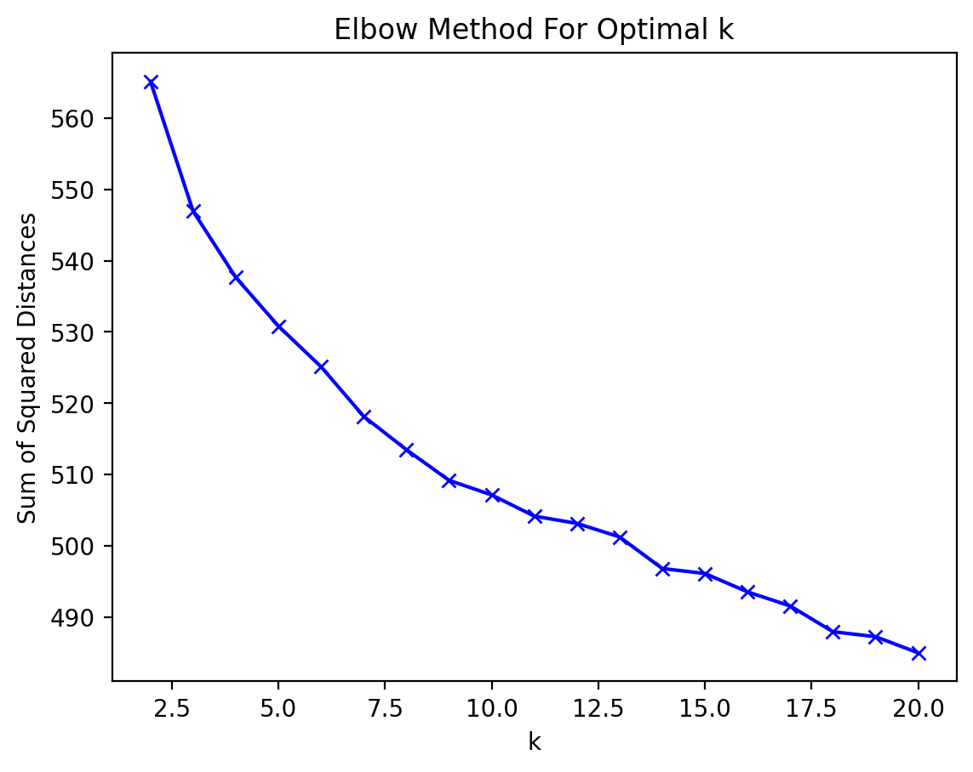
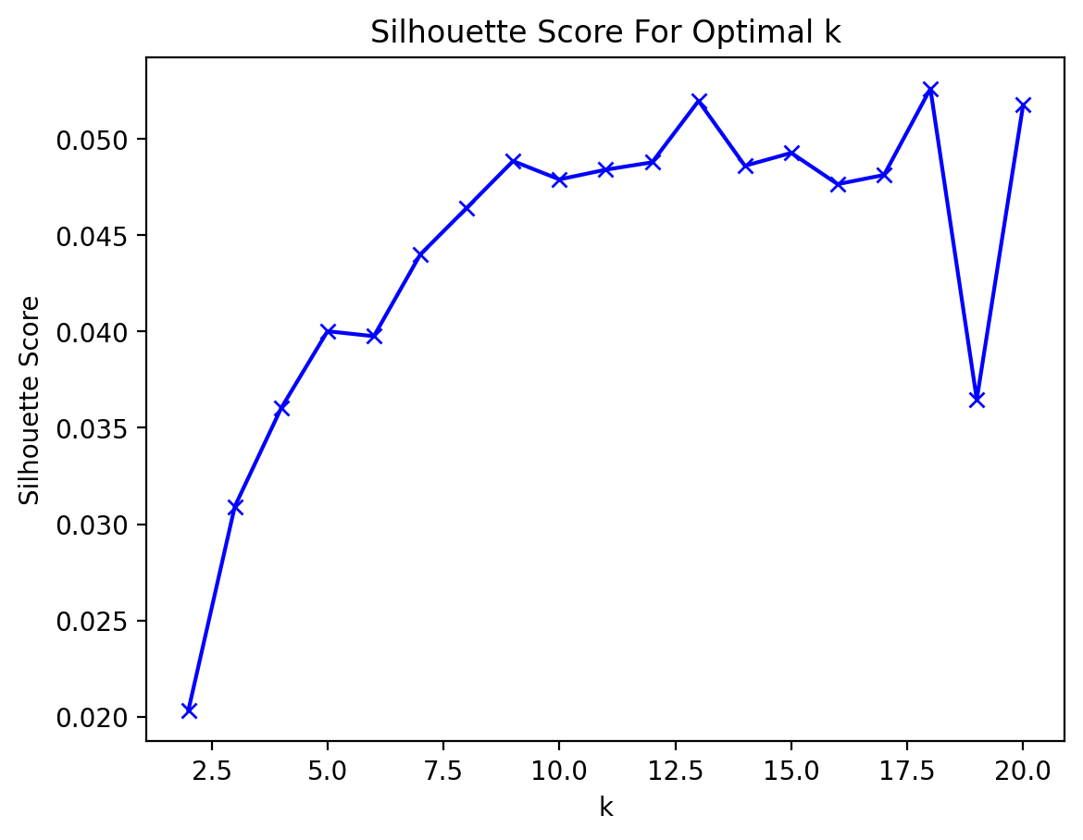
Towards a useful cluster of documents…
We chose a K-Value of 10 for our detailed analysis.

Slide 12
Cluster # | # Docs | Avg. # Words
1 | 160 | 52.01
3 | 27 | 288.07
5 | 38 | 103.16
7 | 136 | 190.03
9 | 20 | 96.95
Cluster # | # Docs | Avg. # Words
2 | 46 | 809.46
4 | 27 | 288.07
6 | 39 | 164.33
8 | 30 | 16.53
10 | 76 | 657.67

Slide 14
Software Architecture & Implementation
MEASURES | DISTANCE | GRAVITY | DIAMETER
VENUS | 0,11 | 0,45 | 0,17
MERCURY | 0,44 | 0,70 | 0,18
SATURN | 0,75 | 0,32 | 0,47
14

Slide 15
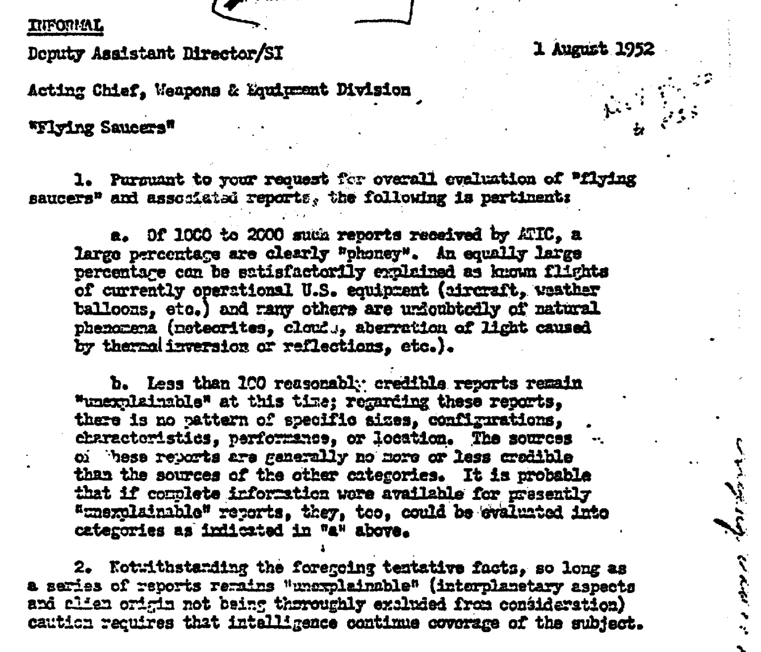
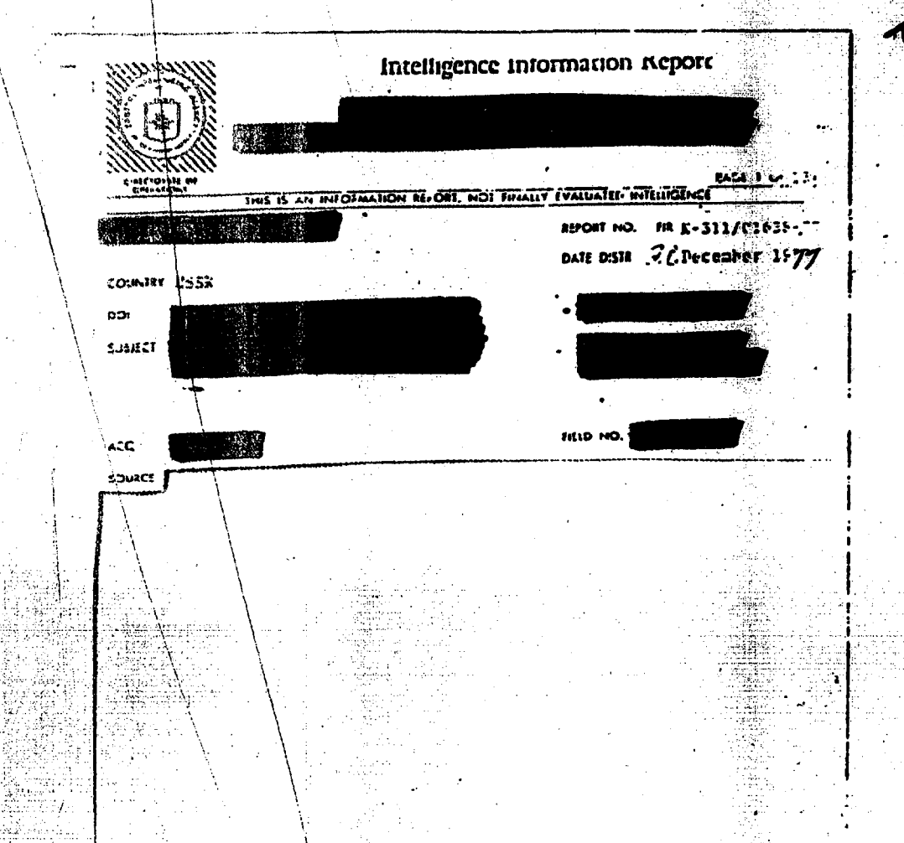
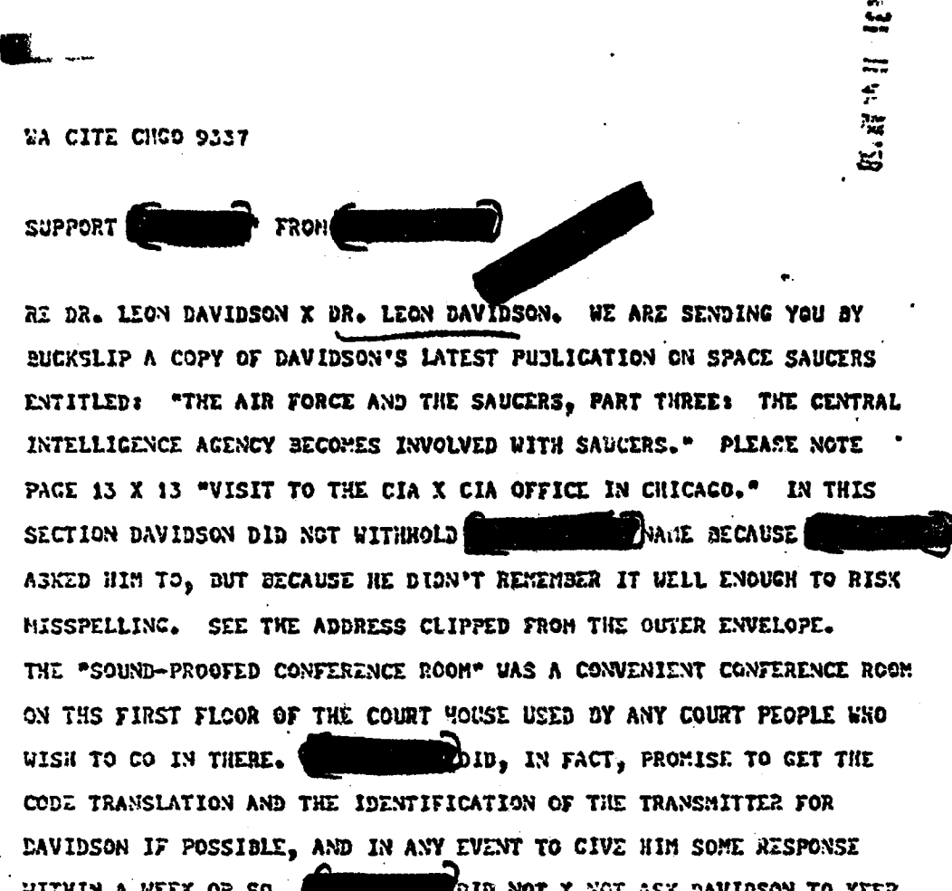
Backend Data Subsystem
Data Processing Pipeline
PDF Converter
Feature
Vectorizer
Model Fitter
File System
Data
Conditioner
Data Processor
Model & Parameter
Admin
Specification of:
Cluster Size
Initialization Method
Iterations
Feature Extraction Method
doc3
Doc | Words
doc1 | [unclass,ufo,saucer,…]
doc2 | [intelligence,report,…]
doc3 | [weapons,equipment,…]
Cluster Data
doc2
doc1
…
Plots
Rendering
Display of:
Optimal Cluster Graph
K-Means Clusters
Word Cloud
Profile of Documents
Streamlit app
Visualization Subsystem

Slide 16



Software FEATURES
 | Process | Upload a set of PDF documents, track their progress through preprocessing, and view basic statistics on their contents.
 | Query | Pass a query string to the VSM and retrieve a specified number of results back from the index, along with the context of the document
 | Explore | View statistics on SSE and Silhouette Scores for Varies K-Values, specify one from 2-20, and view cluster information as results from K-Means.

Slide 17
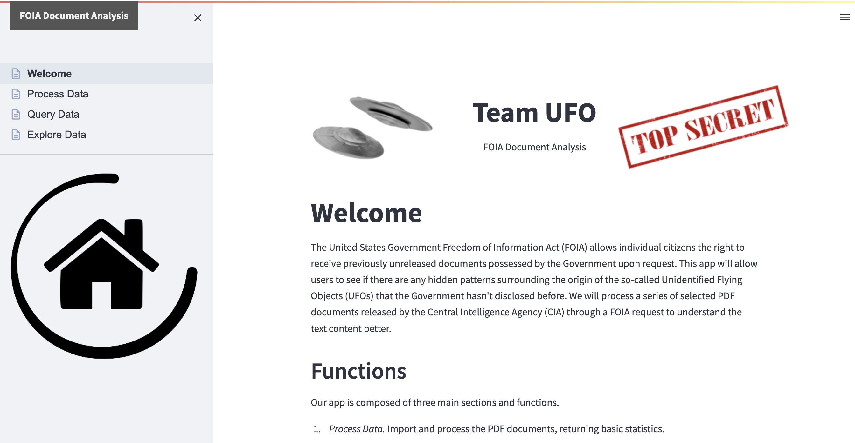
SOFTWARE DEMO
Our Python application, based upon a Streamlit application stack, is available on GitHub at: https://github.com/johnemyers/iste-612/
17

Slide 18
THANK YOU! QUESTIONS?
18

